Slide 1
텍스트마이닝
Present by DW Kim

Slide 2
Contents
1
Word2Vec
2
Glove

Slide 3
Part One
Word2Vec

Slide 4
Word Embedding
기존 정수 인코딩 (Integer Encoding)의 한계?
단어 사이의 _______를 파악하기 어려움
원-핫 인코딩 (One-hot Encoding)의 한계?
___________
희소 표현 (Sparse Representation)

Slide 5
Word Embedding
밀집 표현 (Dense Representation)
One-hot encoding의 ______ 문제를 보완
벡터의 차원을 원하는 대로 설정할 수 있음
데이터를 이용해서 표현을 학습함

Slide 6
Word2Vec
Recap) 단어 사이의 유사도
Korean
English
Japanese
Math
Science
Social Studies

Slide 7
Word2Vec Methods
CBOW (Continuous Bag of Words)
- ______ 단어를 활용해 중간에 있는 단어를 예측
Skip-Gram
- ______ 단어를 활용해 주변에 있는 단어를 예측

Slide 8
CBOW – Continuous Bag of Words
I studied hard for the exam
I studied hard for the exam
I studied hard for the exam
중심 단어
I studied hard for the exam
주변 단어
I studied hard for the exam
I studied hard for the exam

Slide 9
CBOW: One-hot encoded Dataset
I studied hard for the exam
I studied hard for the exam
I studied hard for the exam
중심 데이터
I studied hard for the exam
주변 데이터
I studied hard for the exam
I studied hard for the exam

Slide 10
CBOW: Network Structure
*토큰화/불용어 제거 생략
onehot{studied}
I studied hard for the exam
onehot{hard}
onehot{for}
onehot{the}
onehot{exam}
Input Layer
Projection Layer
Output Layer

Slide 11
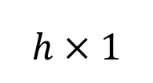
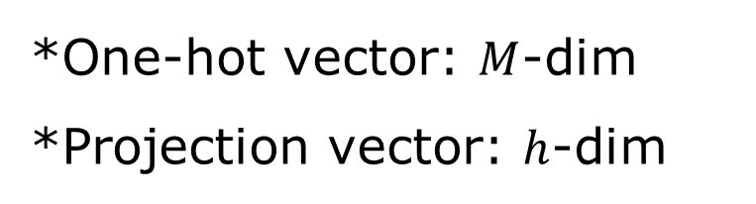
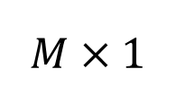
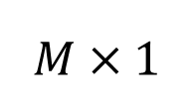
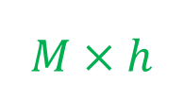
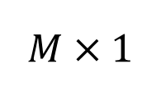
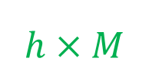
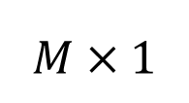
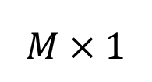
CBOW: Weight Matrix
*One-hot vector: $M$-dim
*Projection vector: $h$-dim
$$M×1$$
$$h×M$$
$$M×1$$
$$M×h$$
$$M×1$$
$$M×1$$
$$h×1$$
$$M×1$$
Input Layer
Projection Layer
Output Layer

Slide 12
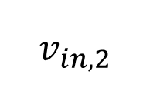
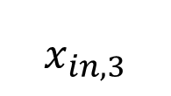

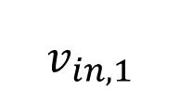
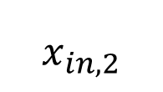
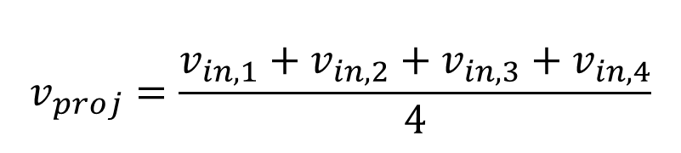
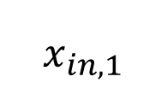

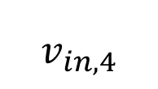
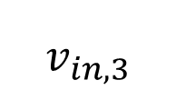
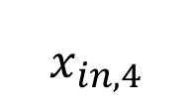
CBOW: Input $→$ Projection
*One-hot vector: $M$-dim
*Projection vector: $h$-dim
$$x_{in,1}$$
$$v_{in,1}$$
$$v_{proj}=\frac{v_{in,1}+v_{in,2}+v_{in,3}+v_{in,4}}{4}$$
$$x_{in,2}$$
$$v_{in,2}$$
$$v_{in,3}$$
$$v_{in,k}=W_{I→p}x_{in,k}$$
$$x_{in,3}$$
$$v_{in,4}$$
$$h×1$$
$$x_{in,4}$$
Input Layer
Projection Layer

Slide 13
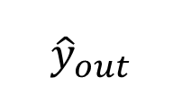

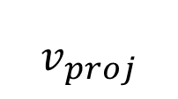


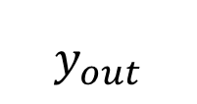
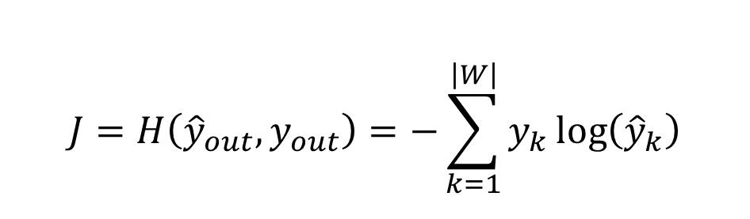
CBOW: Projection $→$ Output
*One-hot vector: $M$-dim
*Projection vector: $h$-dim
$$v_{out}=W_{p→o}v_{proj}$$
$${\hat{y}}_{out}=softmax\left(v_{out}\right)$$
$$v_{proj}$$
$${\hat{y}}_{out}$$
$$y_{out}$$
$$J=H\left({\hat{y}}_{out}, y_{out}\right)=−\sum_{k=1}^{\left|W\right|}{y_{k}\log\left({\hat{y}}_{k}\right)}$$
Projection Layer
Output Layer

Slide 14
SkipGram – 중심에서 주변으로
I studied hard for the exam
I studied hard for the exam
I studied hard for the exam
중심 단어
I studied hard for the exam
주변 단어
I studied hard for the exam
I studied hard for the exam

Slide 15
SkipGram – Any difference?
onehot{studied}
I studied hard for the exam
onehot{hard}
onehot{for}
onehot{the}
onehot{exam}
Output Layer
Projection Layer
Input Layer

Slide 16

CBOW & SkipGram: Recap

Slide 17
NNLM: NN-Language Model
Recap) N-gram Language Model
Neural network is essential for machine learning technique.
Neural network is essential for machine _______
= ___-gram language model

Slide 18
NNLM: NN-Language Model
Neural network is essential for machine learning technique.
essential,
for,
machine
Neural
Network
learning
for,
machine,
learning
Neural
Network
technique

Slide 19
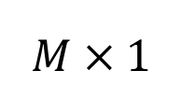
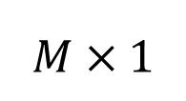
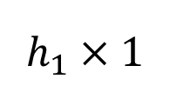
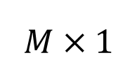
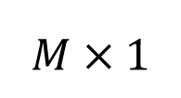
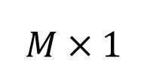
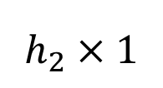
NNLM: Network Structure
$$M×1$$
$$M×1$$
$$M×1$$
$$M×1$$
$$h_{1}×1$$
$$h_{2}×1$$
$$M×1$$
Input Layer
Hidden Layer
Output Layer

Slide 20
NNLM: Limitations
NNLM은 ______ 길이의 과거 정보만을 참조하므로 ______ 정보를 파악할 수 없다.
문장의 길이가 달라질 경우 한계점이 명확하다.

Slide 21
NNLM vs Word2Vec (CBOW)
구조적인 차이
연산량의 차이:
예측 대상의 차이:

Slide 22
SGNS: SkipGram with Negative Sampling
Problems with the SkipGram & CBOW?
단어 수가 많아진다면?
학습 대상: 과학
주변 단어: 수학
그 외 단어: 하늘, 바람, 별, …

Slide 23
Negative Sampling
Negative Sampling은 Word2Vec 학습 과정에서 학습 대상의 단어와 관련이 높은 단어들에 보다 집중한다.
SkipGram: ____ 단어로부터 ____ 단어를 예측
SGNS: 선택된 두 단어가 ____ 단어와 ____ 단어 관계인가?

Slide 24
SkipGram vs SGNS
I studied hard for the exam
SkipGram
for
hard
SGNS
for
0.95
hard

Slide 25
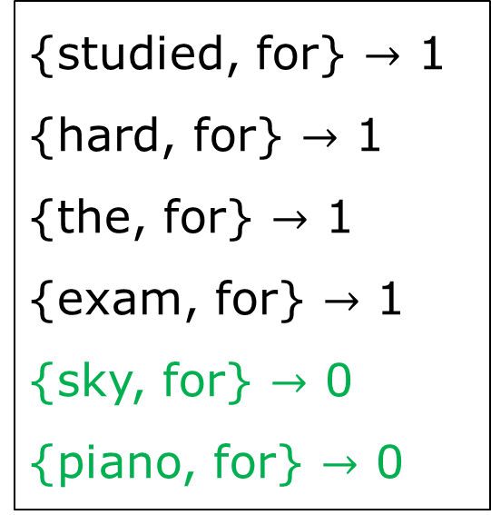
SGNS: Overview
I studied hard for the exam
{studied, for} $→$ 1
{hard, for} $→$ 1
{the, for} $→$ 1
{exam, for} $→$ 1
{sky, for} $→$ 0
{piano, for} $→$ 0
Train the Neural Network!

Slide 26
SGNS: Neural Network
I studied hard for the exam
for
0.85
1
hard
Loss

Slide 27
Interim Summary

Slide 28
Part Two
GloVe

Slide 29
Co-occurrence Matrix
I like studying math.
I enjoy studying math.

Slide 30
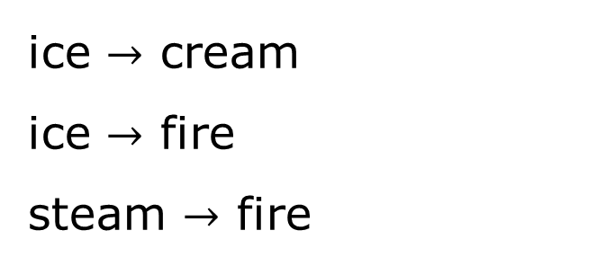
Co-occurrence Probability
ice $→$ cream
ice $→$ fire
steam $→$ fire

Slide 31
GloVe: Main Idea
중심 단어와 주변 단어 벡터의 내적 = Corpus 동시 등장 확률
???

Slide 32
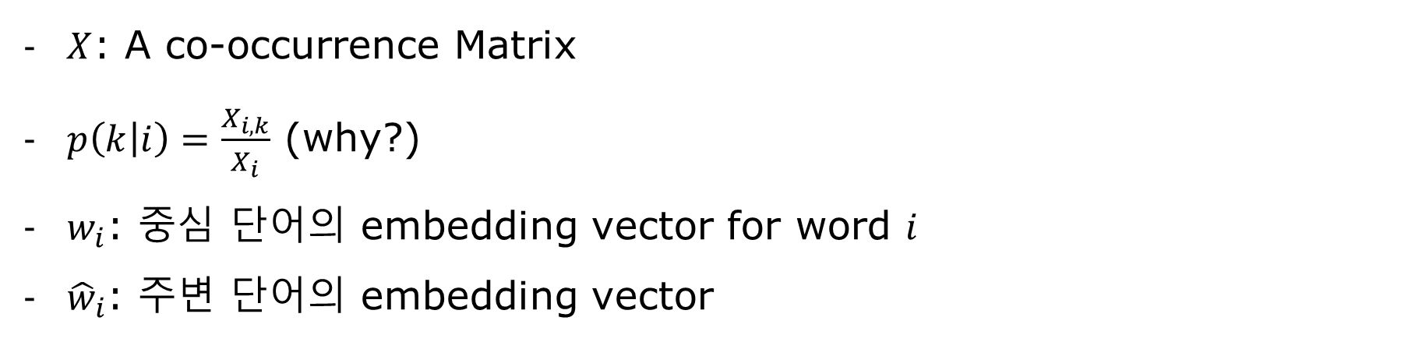
GloVe: Nomenclature
$X$: A co-occurrence Matrix
$p\left(k | i\right)=\frac{X_{i,k}}{X_{i}}$ (why?)
$w_{i}$: 중심 단어의 embedding vector for word $i$
${\hat{w}}_{i}$: 주변 단어의 embedding vector

Slide 33


GloVe: Main Idea
중심 단어와 주변 단어 벡터의 내적 = Corpus 동시 등장 확률
$$<w_{i},w_{k}>$$
$$\log{p(k|i) }$$

Slide 34
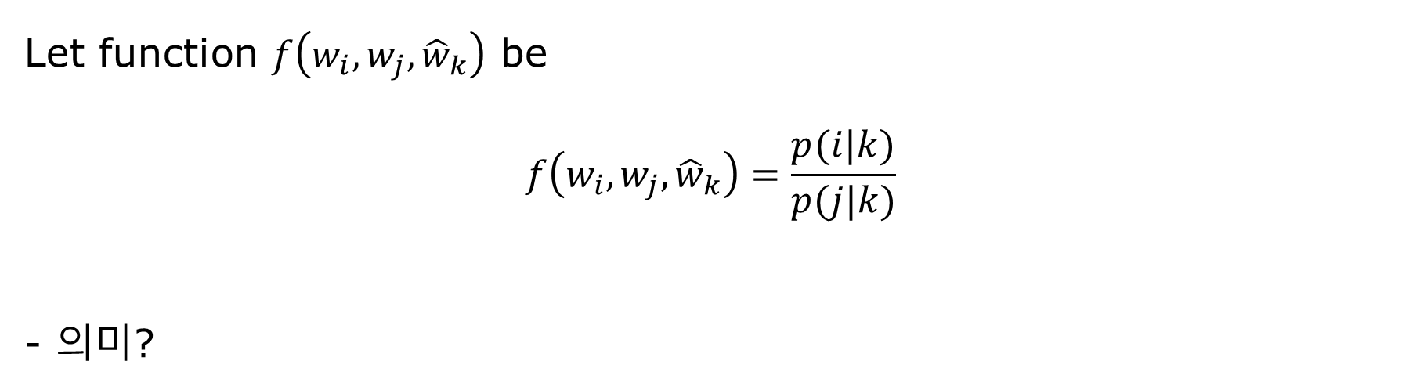
GloVe: Loss Function
Let function $f\left(w_{i},w_{j},{\hat{w}}_{k}\right)$ be
$$f\left(w_{i},w_{j},{\hat{w}}_{k}\right)=\frac{p(i|k)}{p(j|k)}$$
- 의미?

Slide 35
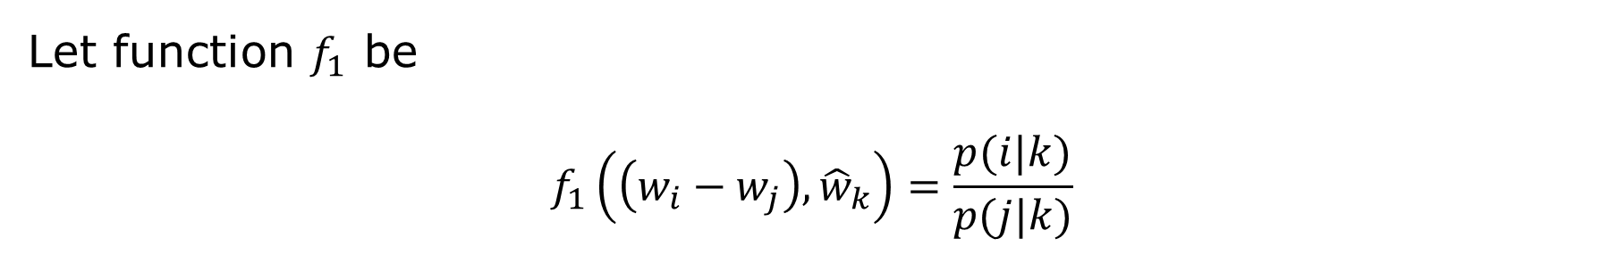
GloVe: Loss Function
Let function $f_{1}$ be
$$f_{1}\left(\left(w_{i}−w_{j}\right),{\hat{w}}_{k}\right)=\frac{p(i|k)}{p(j|k)}$$

Slide 36
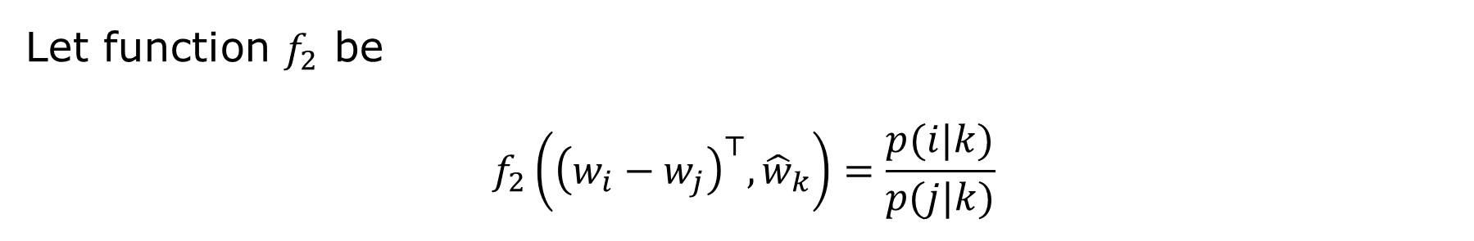
GloVe: Loss Function
Let function $f_{2}$ be
$$f_{2}\left({\left(w_{i}−w_{j}\right)}^{⊤},{\hat{w}}_{k}\right)=\frac{p(i|k)}{p(j|k)}$$

Slide 37
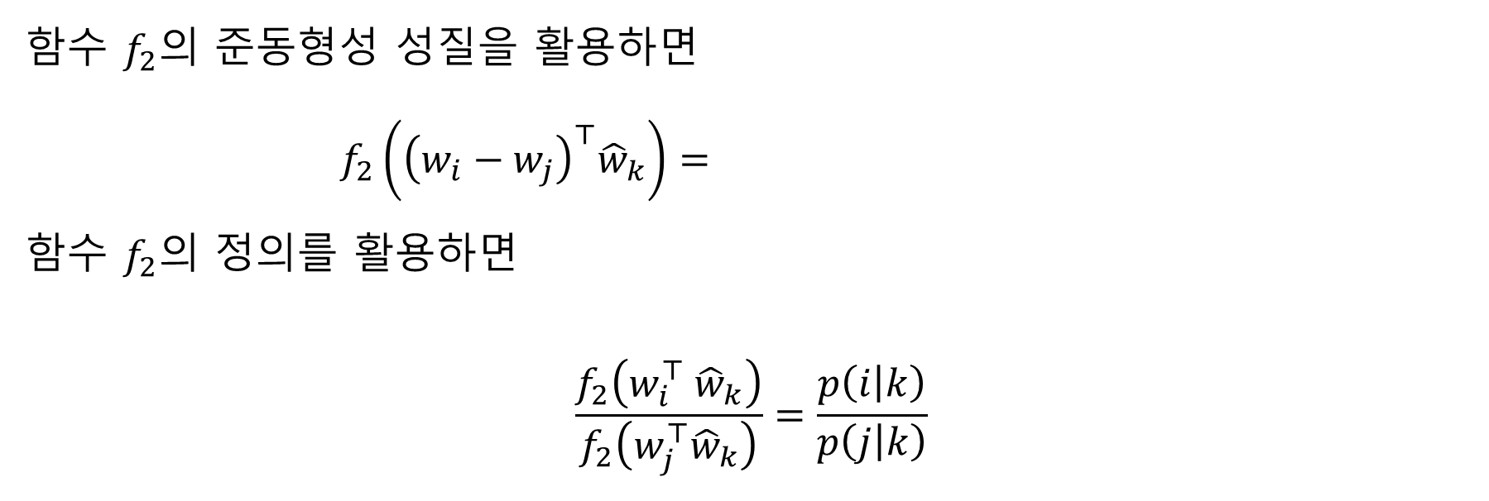
GloVe: Loss Function
함수 $f_{2}$의 준동형성 성질을 활용하면
$$f_{2}\left({\left(w_{i}−w_{j}\right)}^{⊤}{\hat{w}}_{k}\right)=$$
함수 $f_{2}$의 정의를 활용하면
$$\frac{f_{2}\left(w_{i}^{⊤} {\hat{w}}_{k}\right)}{f_{2}\left(w_{j}^{⊤}{\hat{w}}_{k}\right)}=\frac{p\left(i | k\right)}{p\left(j | k\right)}$$

Slide 38

GloVe: Loss Function
함수 $f_{2}$의 정의를 활용하면
$$\frac{f_{2}\left(w_{i}^{⊤}{\hat{w}}_{k}\right)}{f_{2}\left(w_{j}^{⊤}{\hat{w}}_{k}\right)}=\frac{p\left(i | k\right)}{p\left(j | k\right)}$$
If $f_{2}\left(⋅\right)≔exp⁡(⋅)$;
$$\exp\left(w_{i}^{⊤}{\hat{w}}_{k}\right)=p\left(i | k\right)$$
Then,
$$w_{i}^{⊤}{\hat{w}}_{k}=\log{p\left(i | k\right)}$$

Slide 39
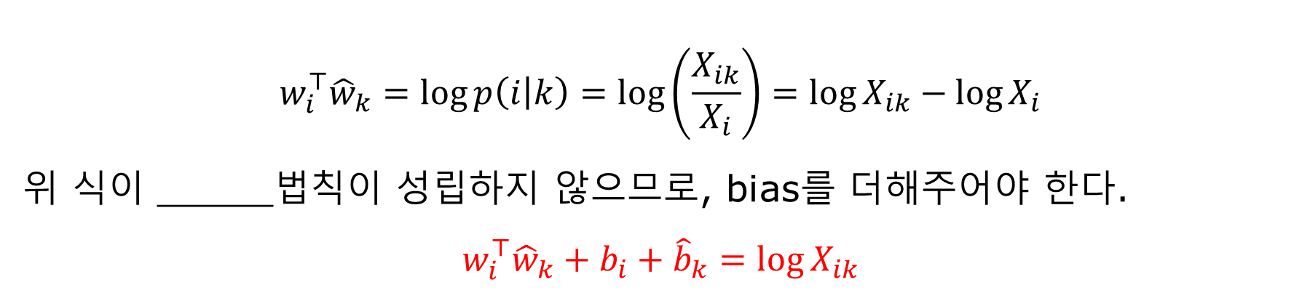
GloVe: Loss Function
$$w_{i}^{⊤}{\hat{w}}_{k}=\log{p\left(i | k\right)}=\log\left(\frac{X_{ik}}{X_{i}}\right)=\log{X_{ik}}−\log{X_{i}}$$
위 식이 _____법칙이 성립하지 않으므로, bias를 더해주어야 한다.
$$w_{i}^{⊤}{\hat{w}}_{k}+b_{i}+{\hat{b}}_{k}=\log{X_{ik}}$$

Slide 40

GloVe: Loss Function
$$w_{i}^{⊤}{\hat{w}}_{k}+b_{i}+{\hat{b}}_{k}=\log{X_{ik}}$$
최종적으로, loss function은
$$Loss=$$

Slide 41
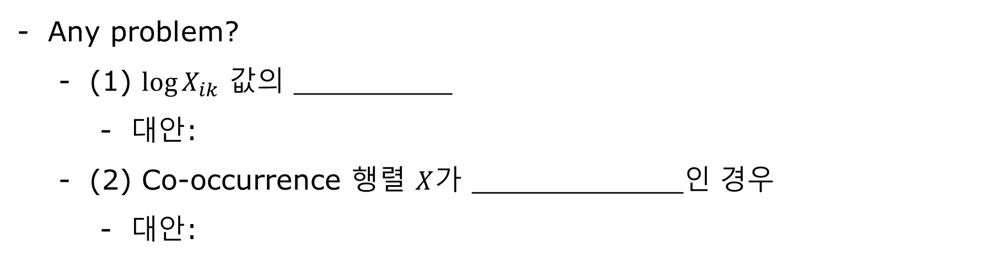
GloVe: Loss Function
Any problem?
(1) $\log{X_{ik}}$ 값의 _________
대안:
(2) Co-occurrence 행렬 $X$가 ____________인 경우
대안:

Slide 42
GloVe: Recap

